Slide 1
Your Medical Blog
Zero to Hero Guide
Mark Seigel, MD, FACOG
Chair, ACOG Committee on Practice Management
Co-Chair, Physicians’ Electronic Health Record Coalition

Slide 2
Disclosure
I have no financial interests or industry relationships to disclose.

Slide 3
Learning Objectives
After today, you should be able to:
Choose a domain name
Choose a hosting service
Choose software
Publish your web site

Slide 4
Present Marketing Strategies
Yellow pages
Lunches and Lectures
Word of mouth
Referrals
….They don’t work very well

Slide 5
Where are Patients?
Internet
Google and Facebook
28% have Smart Phones
Not searching through the Yellow
Pages

Slide 6
Patient Behavior has Changed
Patients search for doctors independently through Google
Patients evaluate doctors through web reviews
No web presence decreases likelihood of making appointment

Slide 7
There’s a Disconnect
Patients are on the internet searching for doctors and answers
Doctors are not on the internet
Those doctors who are willing to change will have greater access to patients

Slide 8
What do Patients Want?
Information
Transparency
Availability
Trust

Slide 9
Solution
Web Site
Blog
Social Media

Slide 10
Most Web Sites
Outdated
Stale
Bad/No Rankings

Slide 11
What Kind of Web Site is Best?
Blog is the modern format
Purest form of Social Media
Resource for existing patients
Marketing tool to attract new patients
Allows the user to become involved by submitting a question or comment

Slide 12
Themes
Web design is no longer important
Through themes, design is “turn-key”
Inexpensive
Simple
The comment

Slide 13
The Comment
Empowers the user/reader
Makes the web more interactive. User creates and contributes meaningfully
User created content. Share what you know

Slide 14
Social Media
Social media allows users to engage with others, to share and contribute
It has allowed people to search for connections and trusted sources
People look for ways to connect, allowing for trust and endorsement

Slide 15
Starting Your Site
Choose a domain
Choose a host
Buy the URL (uniform resource locator)
Install WordPress
Publish

Slide 16
Buy the URL
If you are self hosting…
BlueHost.com
GoDaddy.com
“Our” web site will be: http://www.Chooseawebsitename.com

Slide 17
Choose a Domain
Use a combination of 3 popular keywords used in search engines
“www.RockvilleObGynDoctor.com
“www.MarkSeigel.com”
Helps to maximize the Search Engine Optimization of the domain

Slide 18
Bluehost.com

Slide 19
GoDaddy.com

Slide 20
Buy the URL
If WordPress.com is hosting for you…
Go to WordPress.com and do it all there
Give a name to your blog
You will find out if it is available

Slide 21
Blogging Software
Traditional website software is obsolete
  E.g. Dreamweaver, iWeb, FrontPage
Blogging Software
    Server Based
    Best for search engine optimization
    Connected with social media

Slide 22
WordPress software

Slide 23
WordPress is a Content Management System
It allows you to create and manage a website through an administrative interface, including an automatically-generated navigation structure without needing to know HTML or learn any other tool
It is by far the most popular CMS with over 60 million sites worldwide
It’s an excellent platform for a small business or professional website

Slide 24
CMS

Slide 25
Themes

Slide 26
Themes
Over 1200 free/premium themes available
Each has different features and options
  Custom header and/or colors
  Drop down menus
  Widgets
  Custom menus
Explore the available themes and find a match for you

Slide 27
Widgets
You can add features and content to the sidebar
E.g., Twitter updates, list of recent posts, Blog subscription, Archives, Facebook link, and many more.
Plugins are not available on WordPress.com for various security reasons

Slide 28
Sign in, start creating

Slide 29
Static or Dynamic Homepage?
Website has static homepage
Blog has changing homepage

Slide 30
Posts versus Pages
Posts are what makes a blog. They are articles similar to journal entries that are listed in reverse chronological order. All posts appear on the blog’s front page.
Pages are best suited for timeless content your visitors can easily access.
They are more similar to a traditional web site. In a blog they are found in the About Me or Contact sections.
Your blog can consist of a mixture of posts and pages.

Slide 31
Enhance with hyperlinks
You can easily add links to other webpages.
They can be within your website or external.

Slide 32
Connect your blog to social networks

Slide 33
Medical Content
Relevant, Regular, Refreshed
Articles containing the medical information you give in your office
It’s a resource from a trusted source …. You!

Slide 34
Start Tonight
Start your blog
Add regularly
Build your web presence
Show you are different, adaptable, and think outside of the box

Slide 35
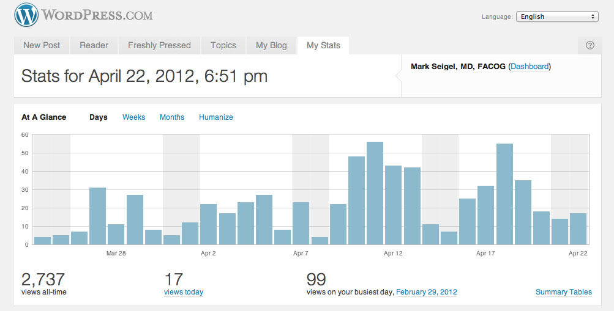
Stats

Slide 36
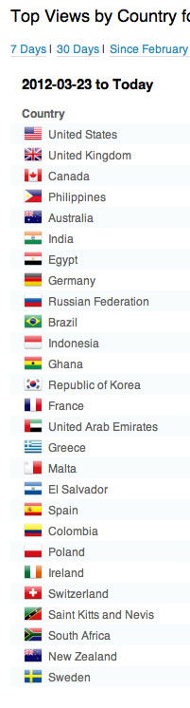
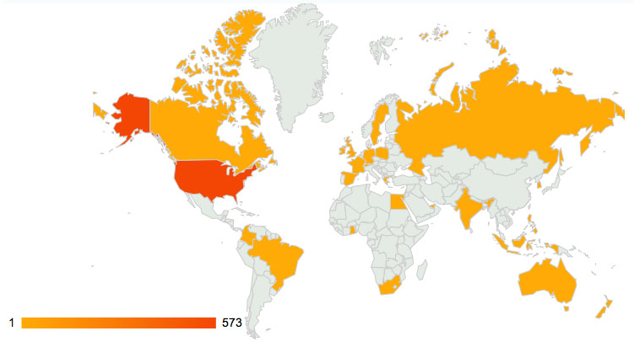
Stats

Slide 37
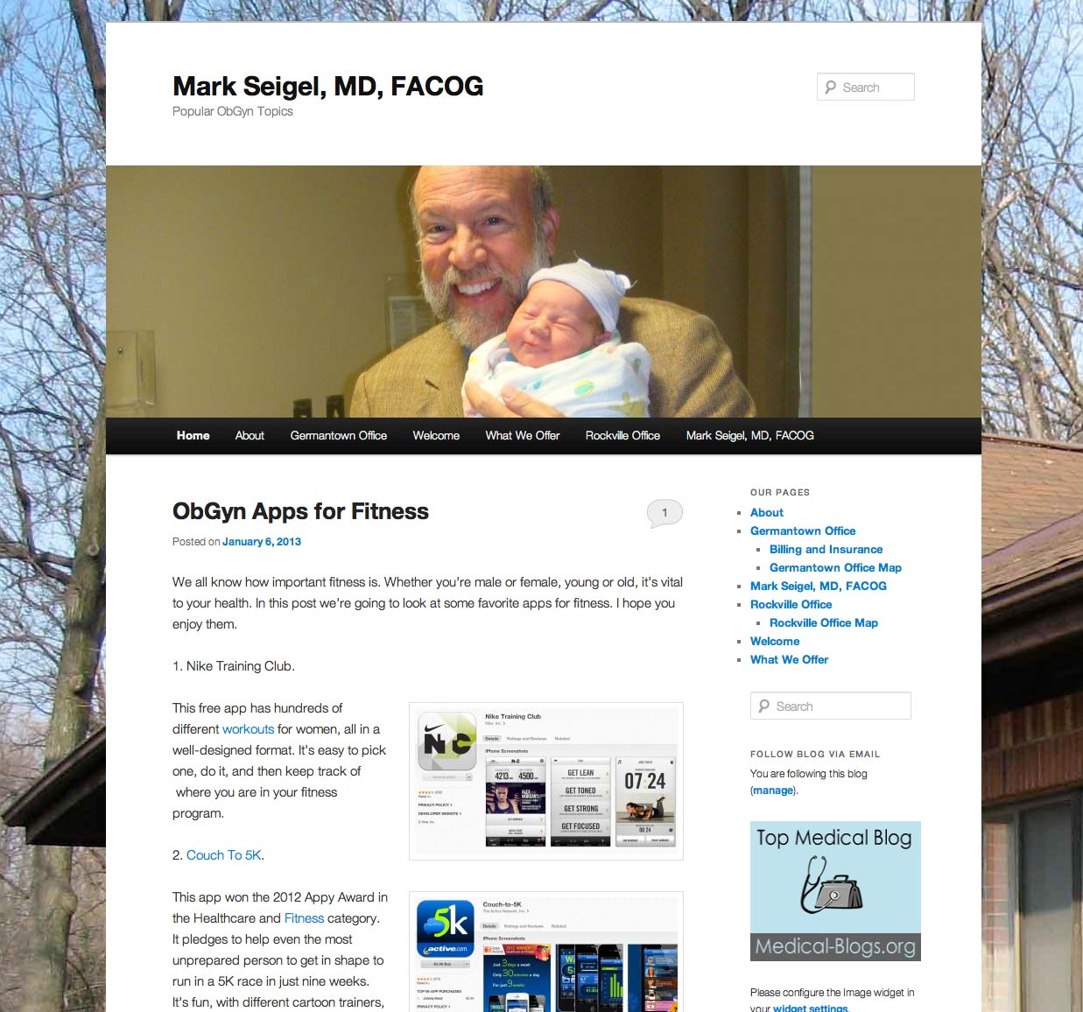

Slide 38
References
http://learn.wordpress.com
Randall V. Wong, M.D. at www.medicalmarketingenterprises.com
Simmons GSLIS WordPress workshop 2011
How to Create Wordpress Websites Easily MarketingOnlineCourses.net

