Slide 1
Social Media 2013
A Guide to Your Success
Mark Seigel, MD, FACOG
Chair, ACOG, Committee on Practice Management
Co-Chair, Physicians’ Electronic Health Record Coalition
George Washington University Medical Faculty Associates

Slide 2
Social Media
I have no financial interests or industry relationships to disclose.

Slide 3
Learning Objectives
Get an introduction to Social Media, and how it’s increased use can change medical practice.
Understand the different Social Media platforms, their uses, and how to get started.
Understand search engine optimization and how it can affect the ranking of your web site.

Slide 5
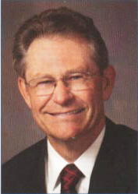

Slide 6
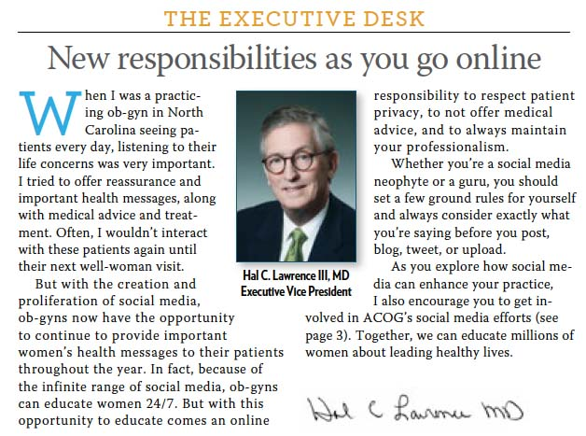
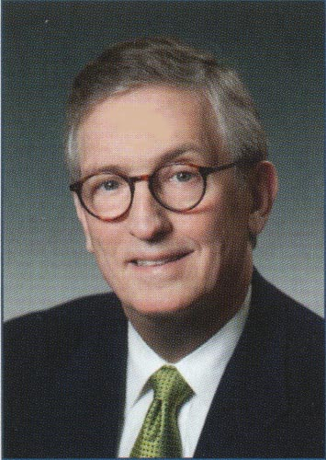

Slide 7

Health 2.0
The use of social applications and other web-based tools (blogs, podcasts, tagging, search, wikis, etc.) to facilitate collaboration among patients and between doctors and patients
The most influential force in the modern redefinition of the physician

Slide 8

Health 2.0

Slide 9
The Creative Destruction of Medicine
How four areas of digital medicine – wireless sensors, genomics, imaging and health information – are about to converge making this the most disruptive period in medicine’s history.
The digital revolution is creating better health care through a coalescence of “the rapidly maturing digital, nonmedical world of mobile devices, cloud computing and social networking with the emerging digital medical world of genomics, biosensors and advanced imaging.”
It gives us a view of the future, emphasizes the expanding role of the patient, and is a call to action to understand how our profession is changing.

Slide 10
MD’s Evolving Role
Technology
MD
Third Party
Diagnostic Imaging
Genomics
Personalized care
Administrative control
Evidence based guidelines
Data collection
Health 2.0
Patient engagement
Social media
Unlimited information

Slide 11
Social Media for Healthcare
It’s a conversation with millions of people.
They talk about us and their experiences.
We can promote our services and help people find us.
We can monitor and protect our reputation.
Our patients are looking for trusted information.
We can be that source.

Slide 12
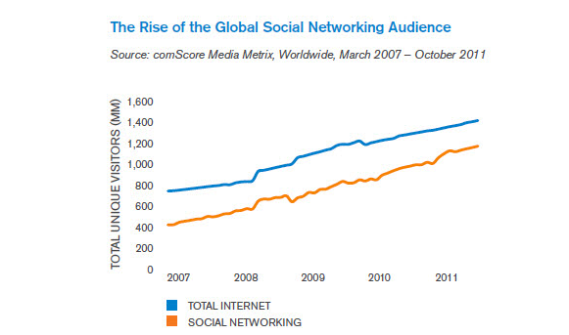
Social Media is the World’s Most Popular Online Activity
In 2011, Social networking accounts for 19% of all time online
In 2007 it was only 6%

Slide 13
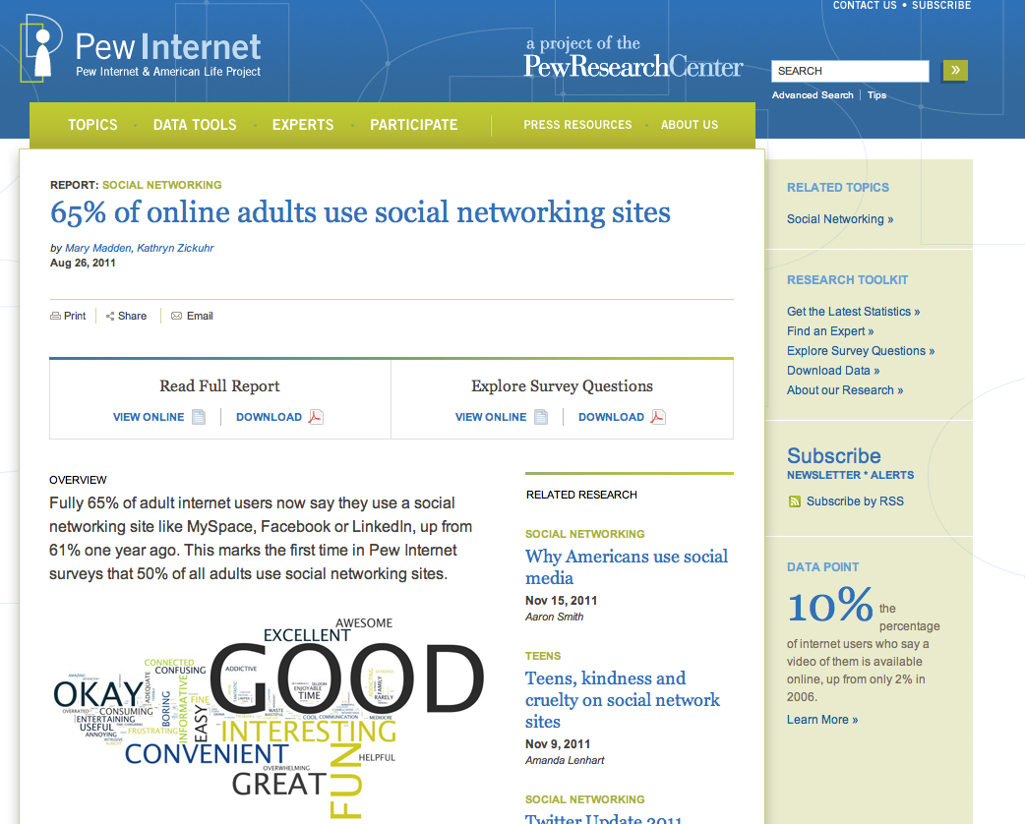
Social Media Use

Slide 14
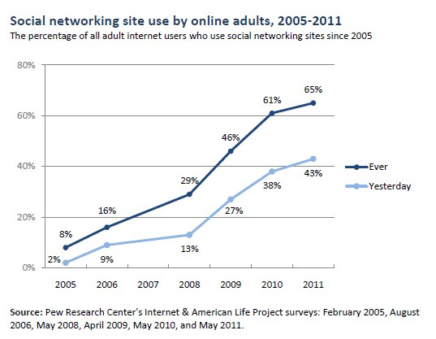
Social Media Use

Slide 15
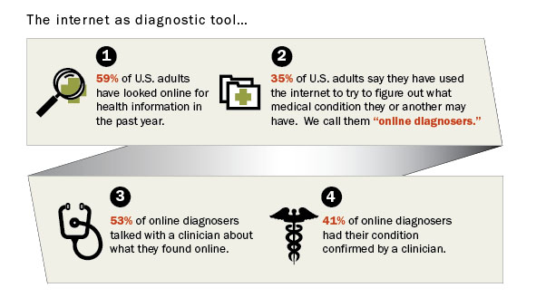
Social Media for Healthcare

Slide 16
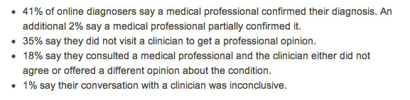
Online Diagnosers

Slide 17
Getting Started
What is my goal?
    Education, Marketing, Advocacy
What is my message?
    List of your Services and Expertise or Change the World?
Who is my audience?
    Patients, Colleagues, Friends, Public
How much time to spend?
What is your Social Media Plan?
Search Engine Optimization

Slide 18
Motivation
Physicians are reluctant to participate in social media due to fear, the lack of knowledge, and the misunderstanding that it is too time consuming and won’t contribute to the practices’ revenue growth.
In today’s fast-paced digital world you must be where your potential patients chose to be. You need to be on a platform that they use.
Today’s on-line world can damage your reputation unless you manage it with positive, accurate content.

Slide 19
Reputation Management
Social media are the way to protect your reputation.
Provide patients with the ability to connect with your practice.
Give patients meaningful content, sharing health-related information.
Enable your patients to tell their stories, share their experiences.
The cornerstone of reputation management is the knowledge of what’s being said about you.
Set up a Google Alert about your practices’ names.

Slide 21
Establish a Core Presence
Establish a foundation, a core or home base on a website, blog or Facebook Page.
This provides you with a place to store meaningful content to share.
Populate your website with useful content.
Enhance your message by starting a blog with Wordpress.
Next you can step onto the Social Media Stage.

Slide 22
First Social Media Steps
Once you have the foundation, look for the platforms where you want to have a presence.
Establish Facebook and Twitter accounts.
Before posting spend some time to learn the platforms.
Above all, be safe. Never share any personal health information of any patient on-line.
Don’t try to de-identify patient information, as it can be re-identified.

Slide 23
Platforms
Facebook
Twitter
Linked In
Pinterest
YouTube
Blogging

Slide 24
Facebook

Slide 25
Facebook stats

Slide 26
Facebook

Slide 27
Facebook

Slide 28
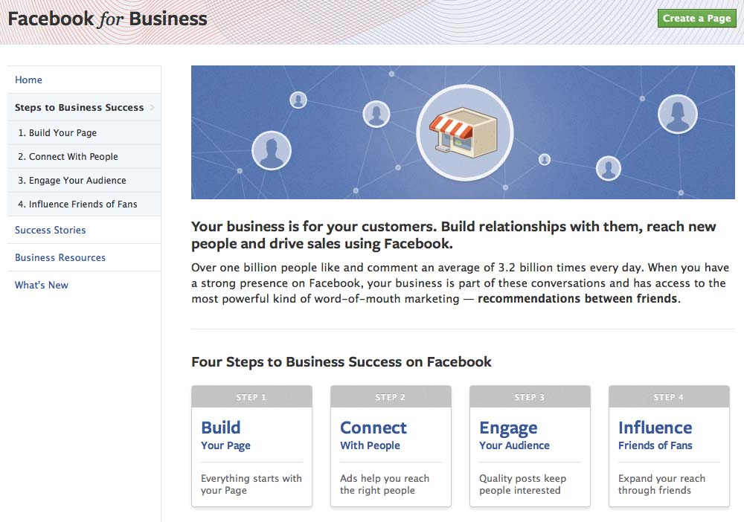
Facebook

Slide 29

How to Set Up a Facebook Page

Slide 30
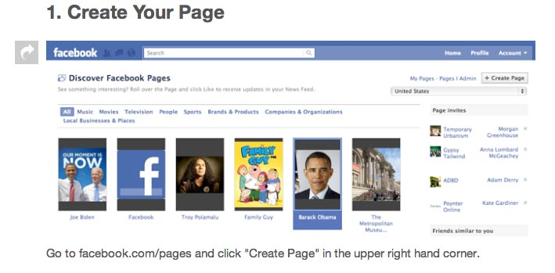
Create Your Page
Fill in Information
Add a Photo (square, less than 4 MB)
Suggest Your Page to Friends

Slide 31
Import Contacts
Start Writing Content

Slide 32
Get a Vanity URL
Use the Tools

Slide 33
Twitter

Slide 34
How I use Twitter
Push: I share web links to health IT and oncology content with my 1300+ followers
Pull: I read tweets of the 300+ people I follow for breaking news, clinical trial results, reports from meetings, health IT policy (remember, Twitter is asymmetric)
Interaction with this personal learning network is replacing time spent surfing news & journal sites
Crowdsourcing questions (needed reference for scholarly article on the use of Twitter in the Egyptian Revolution)

Slide 35
How I use Twitter (cont.)
Use of Twitter at meetings (ASCO AM, ASCO Breast Ca Symposium, Medicine 2.0 Congress, AMIA)
#ASCO10 – 684 users, 4456 tweets
#ASCO11 – 1537 users, 8188 tweets
Networking opportunities from being visible on Twitter: IRB-approved research on SM, invited commentary in national oncology periodical, interviewed by AMA News on health IT topic, invited to lecture at class for physician writers at Johns Hopkins, develop ties to national breast cancer advocacy community

Slide 36
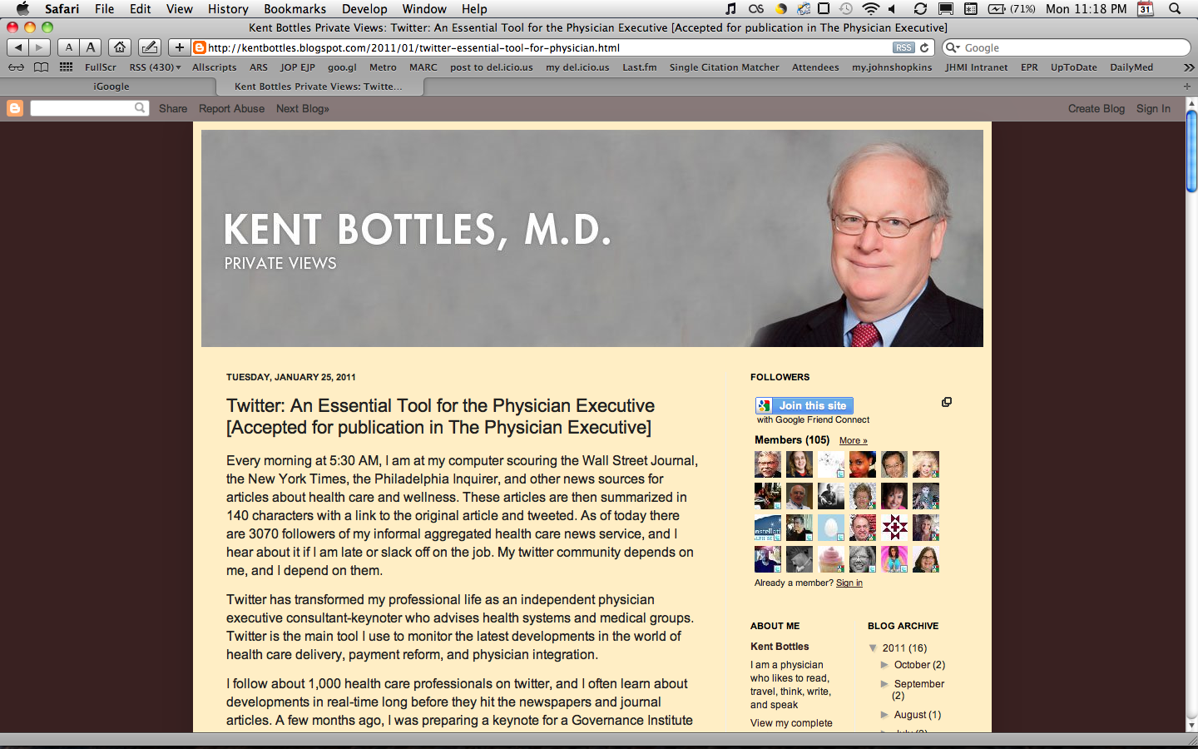
Develop community of fellow Twitter users
Speaking and consulting gigs
“My research department works for free and is scattered across U.S.”
Twitter at conferences

Slide 37
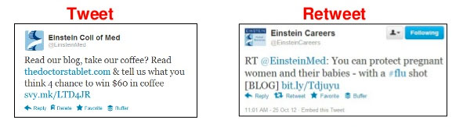
Tweet and Retweet
Tweet refers to a short message (140 Character max.)
A retweet is a rebroadcast of your message to all of one’s followers.
“RT” usually appears before post.

Slide 38
Do you speak Twitter?
Handle: Your Username: @RockvilleObGyn
Hashtag (#): Symbols used to organize Tweets
Feed: Everything on your Twitter homepage
Following: People you choose to follow
Followers: People who follow you
Mentions: Messages addressing you using your handle: @RockvilleObGyn “Good point!”
Direct Message: Private message sent only to you

Slide 39
Top Twitter Myths
It’s a young person’s thing – in fact, Facebook is for teens and Twitter for adults.
No one is interested – Twitter is a way to educate, connect, learn, market, promote, advocate and engage with a community of people you would not otherwise know.
I don’t have time to tweet – You don’t need time to type 140 characters.
I will not get anything out if it – you get out of it what you put into it. You can tailor who you follow. You can direct message anyone you follow or who follows you.

Slide 40
5 Reasons Hashtags Matter in Healthcare
Access – gives average user access to expertise
Community – gives relationship with influencers
Social Learning – we share our stories
Business Intelligence – equally valuable to listen as it is to participate
Thought Leadership – advance progress of your craft

Slide 41
How to Set Up a Twitter Account
1. Go to http://twitter.com

Slide 42
Join the conversation!

Slide 43
Create a Username

Slide 44
Start connecting

Slide 45
LinkedIn

Slide 46
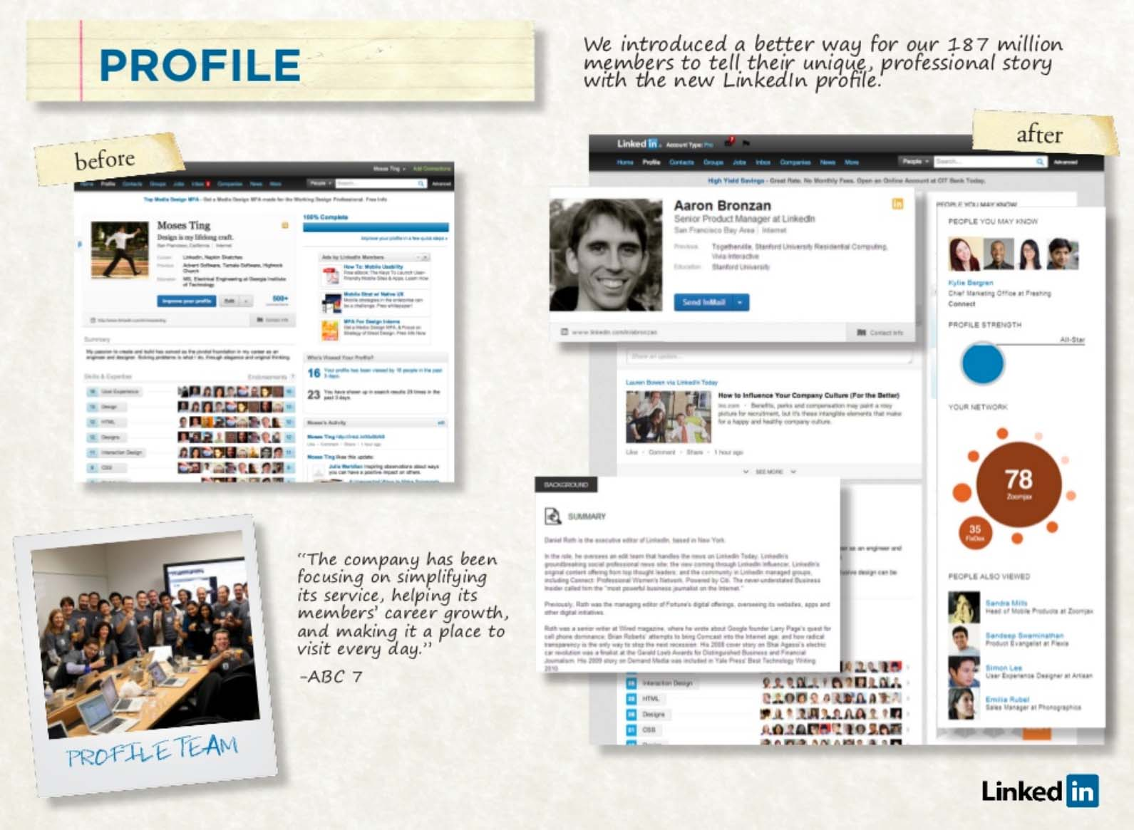

Slide 47
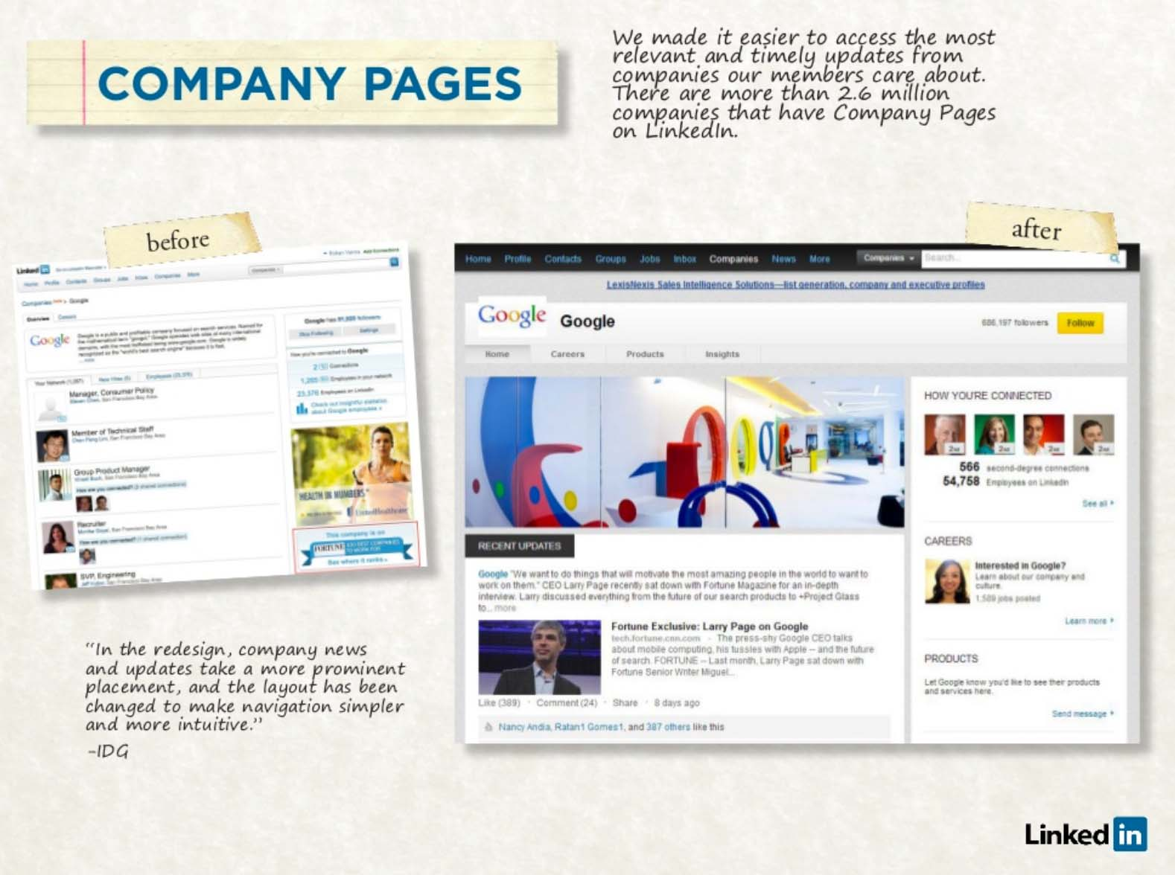

Slide 48
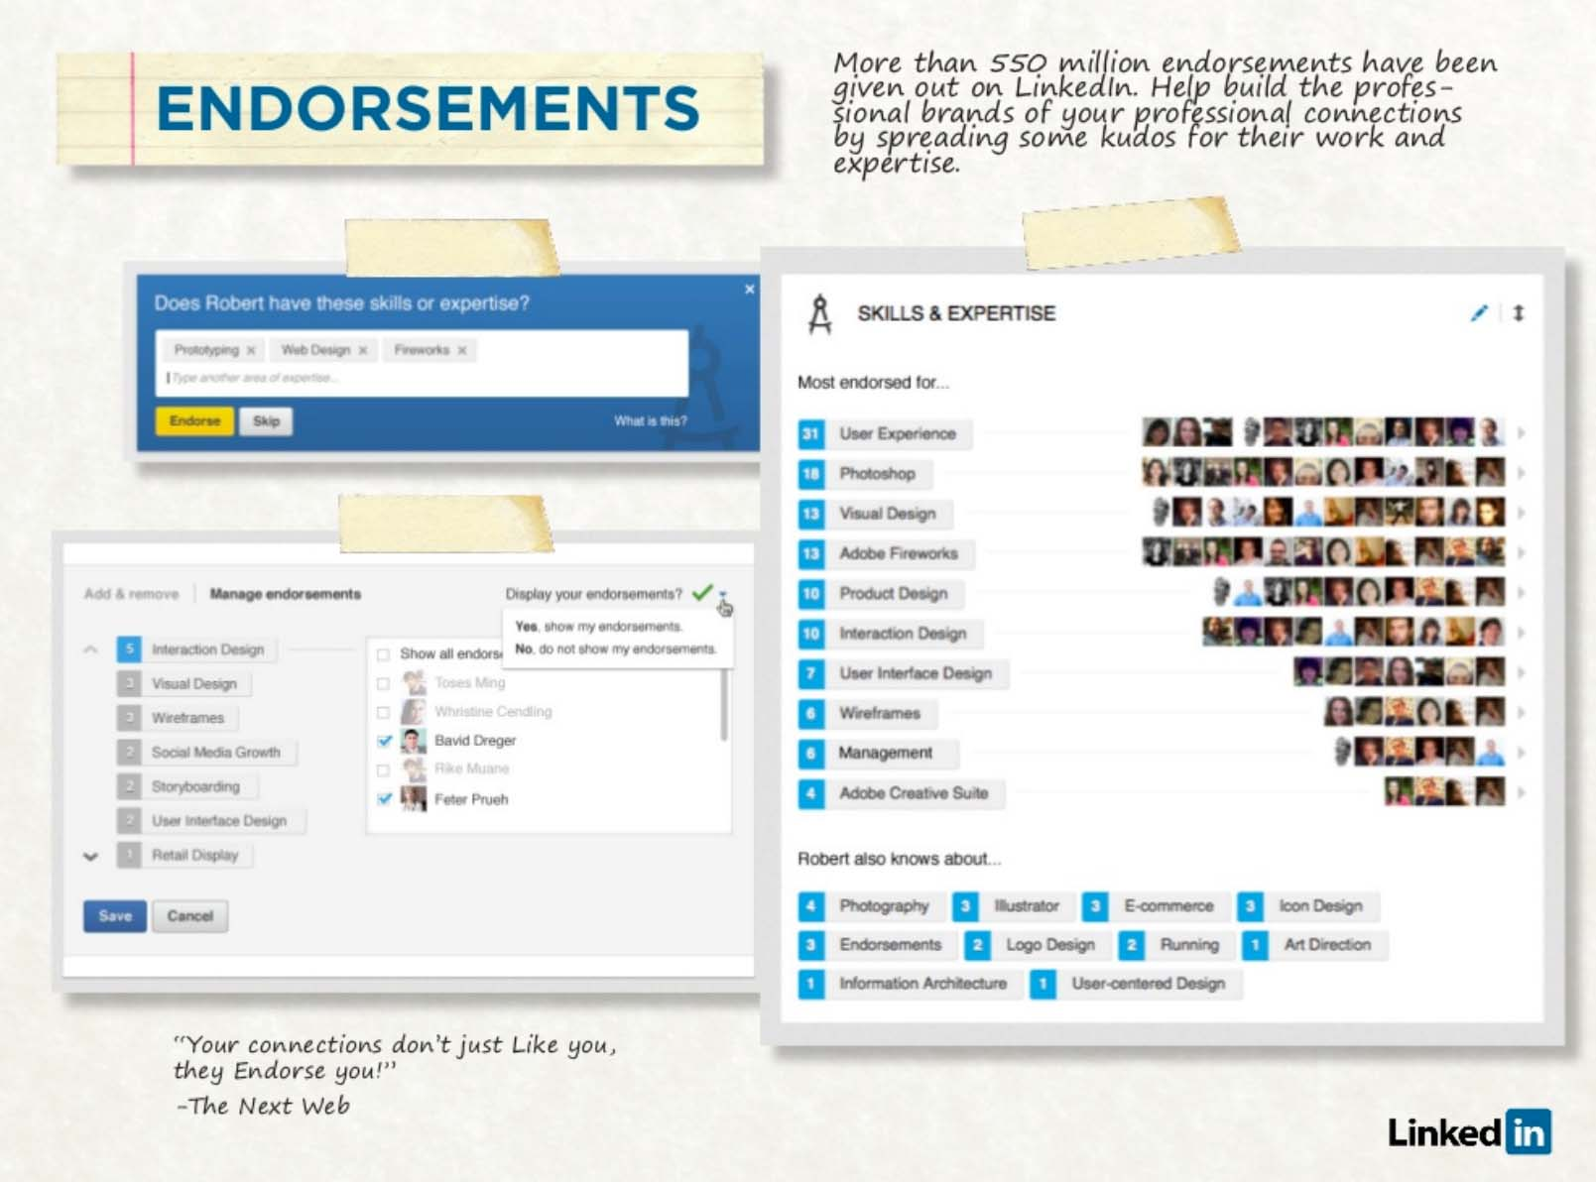

Slide 49
Pinterest
Online pinboard to put your images on a Web page
Share your pins or browse others’ pinboards
Popular tool for weddings, home decoration, recipes
Started in 2009, now over 10 million visitors/month
Fastest growing Social Media site in history
Now valued at $1.5 billion
97% of the fans of Pinterest Facebook page are women

Slide 50


Slide 51
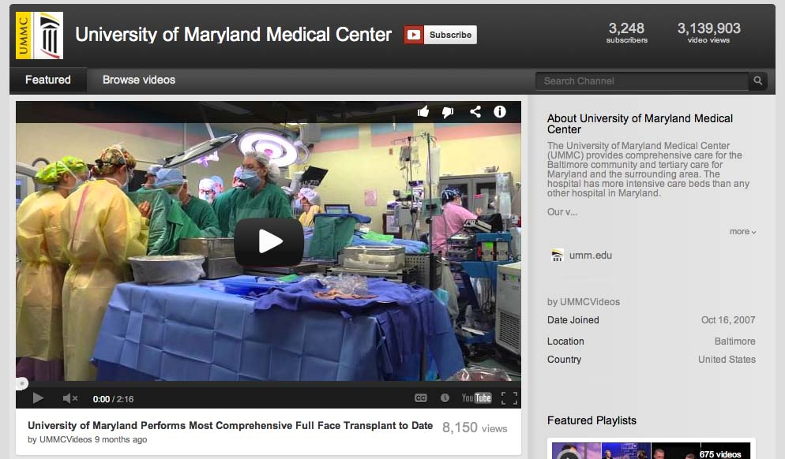
YouTube

Slide 52
Creating a Social Media Plan

Slide 53
Social Media Plan
Secure Your Brand
  Get your brand everywhere you can.
  Have control of your identity all over the Web.
  Search to see if your brand is available.

Slide 54
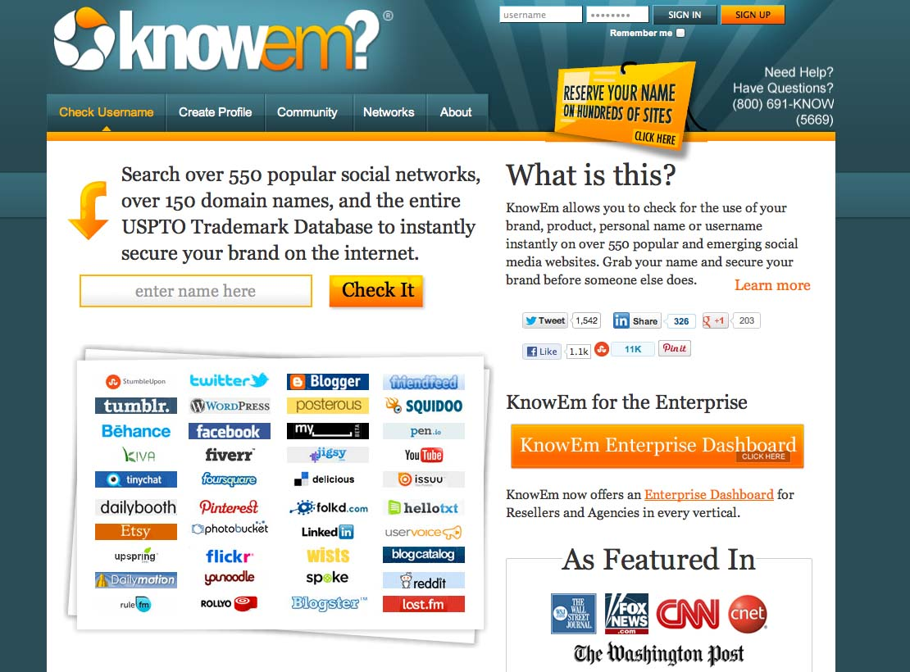

Slide 55
Social Media Plan
Set Your Metrics
  Know what you want to get out of it.
  How do you define success?
  How do you measure it?
Know who you are
  For businesses, marketing is storytelling.
  What are you known for, what do you believe in?
  Get people interested in your story.
Maintain Professionalism
Avoid Liability Exposure

Slide 56
Search Engine Optimization
Search Engine Optimization (SEO) is the process of improving the visibility of a website in a search engine’s natural or “organic” search results.
The higher ranked a site appears on the search engine’s results page, the more frequently it appears on a search results list, the more visitors it will receive from the search engine’s users.
As an Internet strategy, SEO considers how search engines work, what people search for, the actual search terms or keywords typed into search engines.
Optimizing a website may involve editing its content and associated coding to increase its relevance to specific keywords and remove barriers to the indexing activities of search engines.

Slide 57

Search Engine Optimization
Search Engine Optimization allows you to:
Promote your website
Market your practice
Develop a web presence
Attract new patients

Slide 58
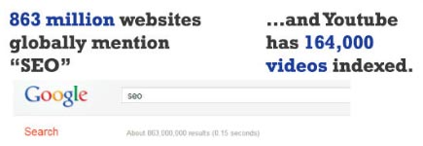
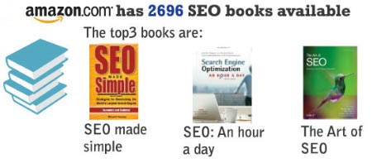
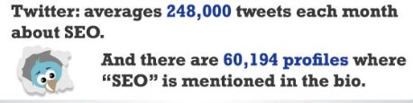

Search Engine Optimization

Slide 59
Search Engine Optimization

Slide 60
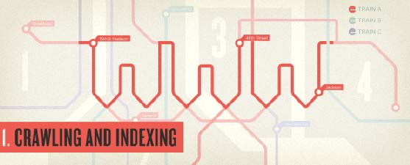
SEO
A Beginner’s Guide
Search engines operate by indexing pages according to text content.

Slide 61
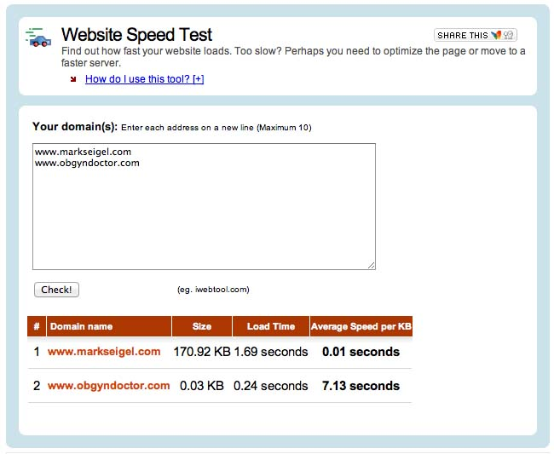
SEO
  Accessibility can be limited by speed.
  Acceptability threshold is 2 seconds for page.

Slide 62
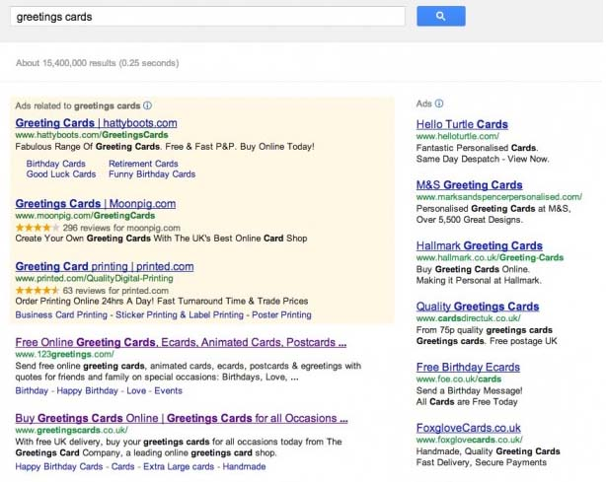
SEO
Keyword Usage and Targeting
  Search engines measure the ways keywords are used on pages to determine relevance and ranking.
  A page’s ranking can be optimized by using keywords in titles and text.

Slide 63
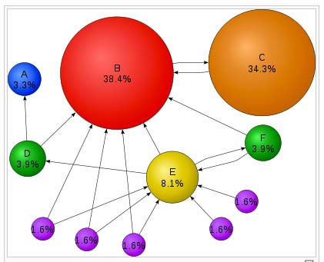
SEO
PageRank
  A link analysis algorithm assigning a weighting to measure relative importance.

Slide 64

SEO
Social Media
  Social networking enables individuals, physicians, hospitals, and patients to create online profiles and connect with one another.
  The patients may be checking your online reputation, the message or image you portray.

Slide 65
SEO Best Practices
Social
Keyword Targeting
Content and Accessibility
Link Popularity

Slide 66
Start Now!
Patients are on-line and looking for information about their physician.
Social media is not just a passing fad.
We must be prepared for an evolving medical environment.
Early adopters have an advantage.
You need proper preparation and planning for it.
The time is now!

Slide 67
References
http://mashable.com/2011/05/22/how-to-facebook-page/
http://www.simplybusiness.co.uk/microsites/guide-to-social-media-success/
http://www.twitip.com/make-a-tweet-plan-to-get-the-most-from-twitter/
http://futuredocsblog.com/top-twitter-myths-tips/
http://socialtimes.com/video-youtube-statistics-2012_b104480
http://www.howardluksmd.com/orthopedic-social-media/physician-social-media-presence-hjl20/
http://pewinternet.org/Reports/2013/Health-online/Summary-of-Findings.aspx
#HCSM, #HITSM
http://blog.himss.org/2012/06/05/5-reasons-hashtags-matter-in-healthcare/

Slide 68
